Slide 1
Reduced Carbon Concrete
Kevin Senn, PE
2024 Nevada Transportation Conference
May 7, 2024

Slide 2
Overview
Background
Quantifying Impact
Carbon Reduction Strategies
Funding Opportunities

Slide 3
Background

Slide 4
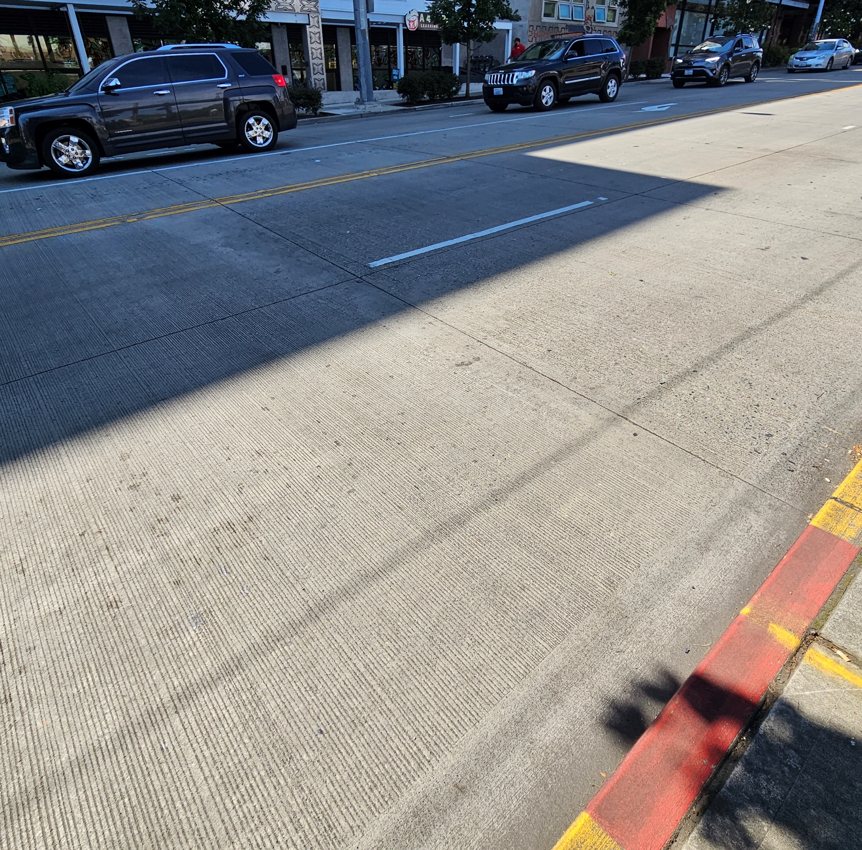
Why do we use so much concrete?
Concrete is humankind’s most widely used construction material.
  Low cost
  Versatility
  Robustness
  Local availability
Higher initial cost but less maintenance over its lifespan.
Smooth and safe – improved fuel efficiency.
Photo: NCE

Slide 5
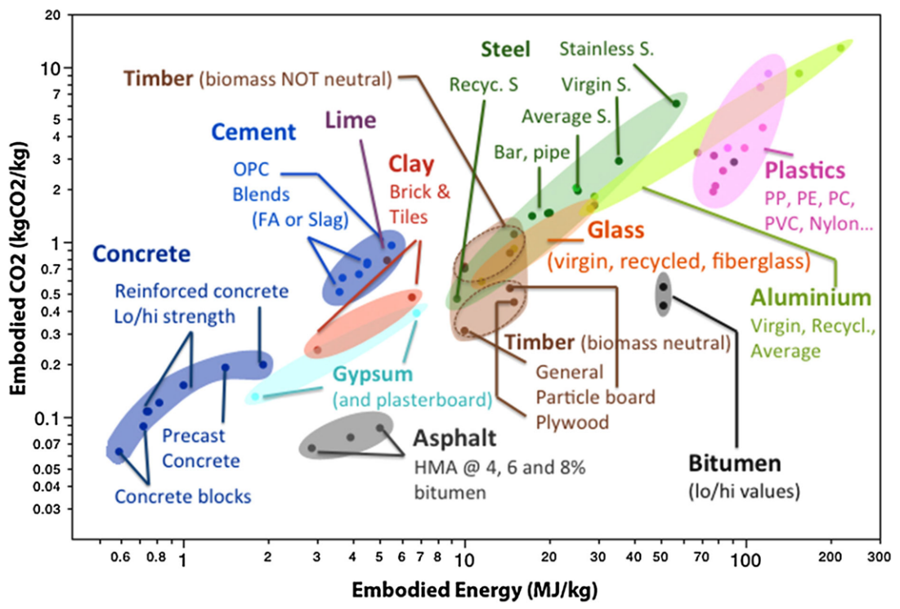
Concrete’s Carbon Footprint
Unit-mass basis – concrete has one of the lowest carbon footprints of all manufactured materials.
Enormous use of concrete acts as a multiplier.
Most carbon intensive part of concrete is cement.
~90% of cement emissions come from clinker production.
  Calcination of limestone, fossil fuel combustion needed to achieve high kiln temperatures.
From: Barcelo et. al, 2013

Slide 6
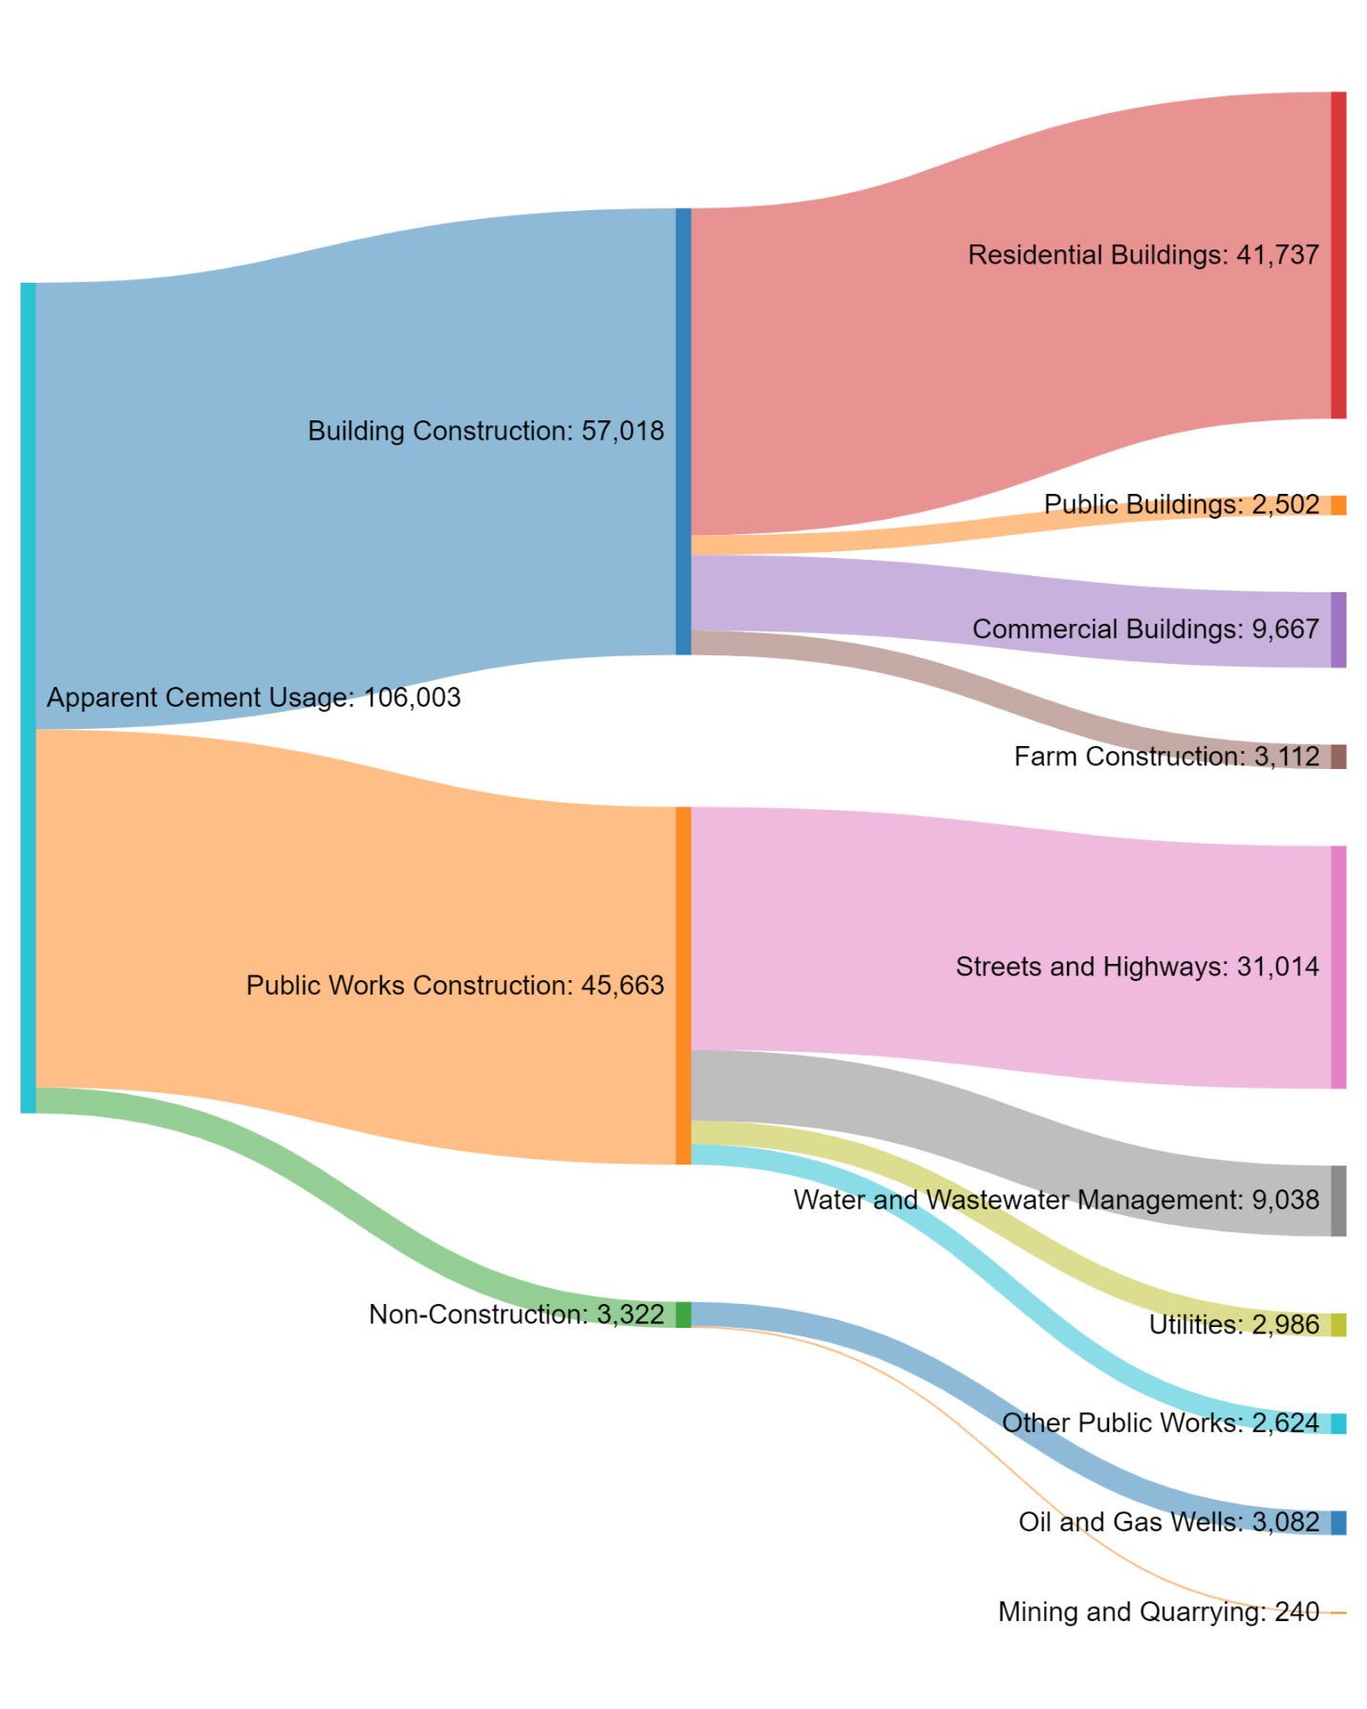
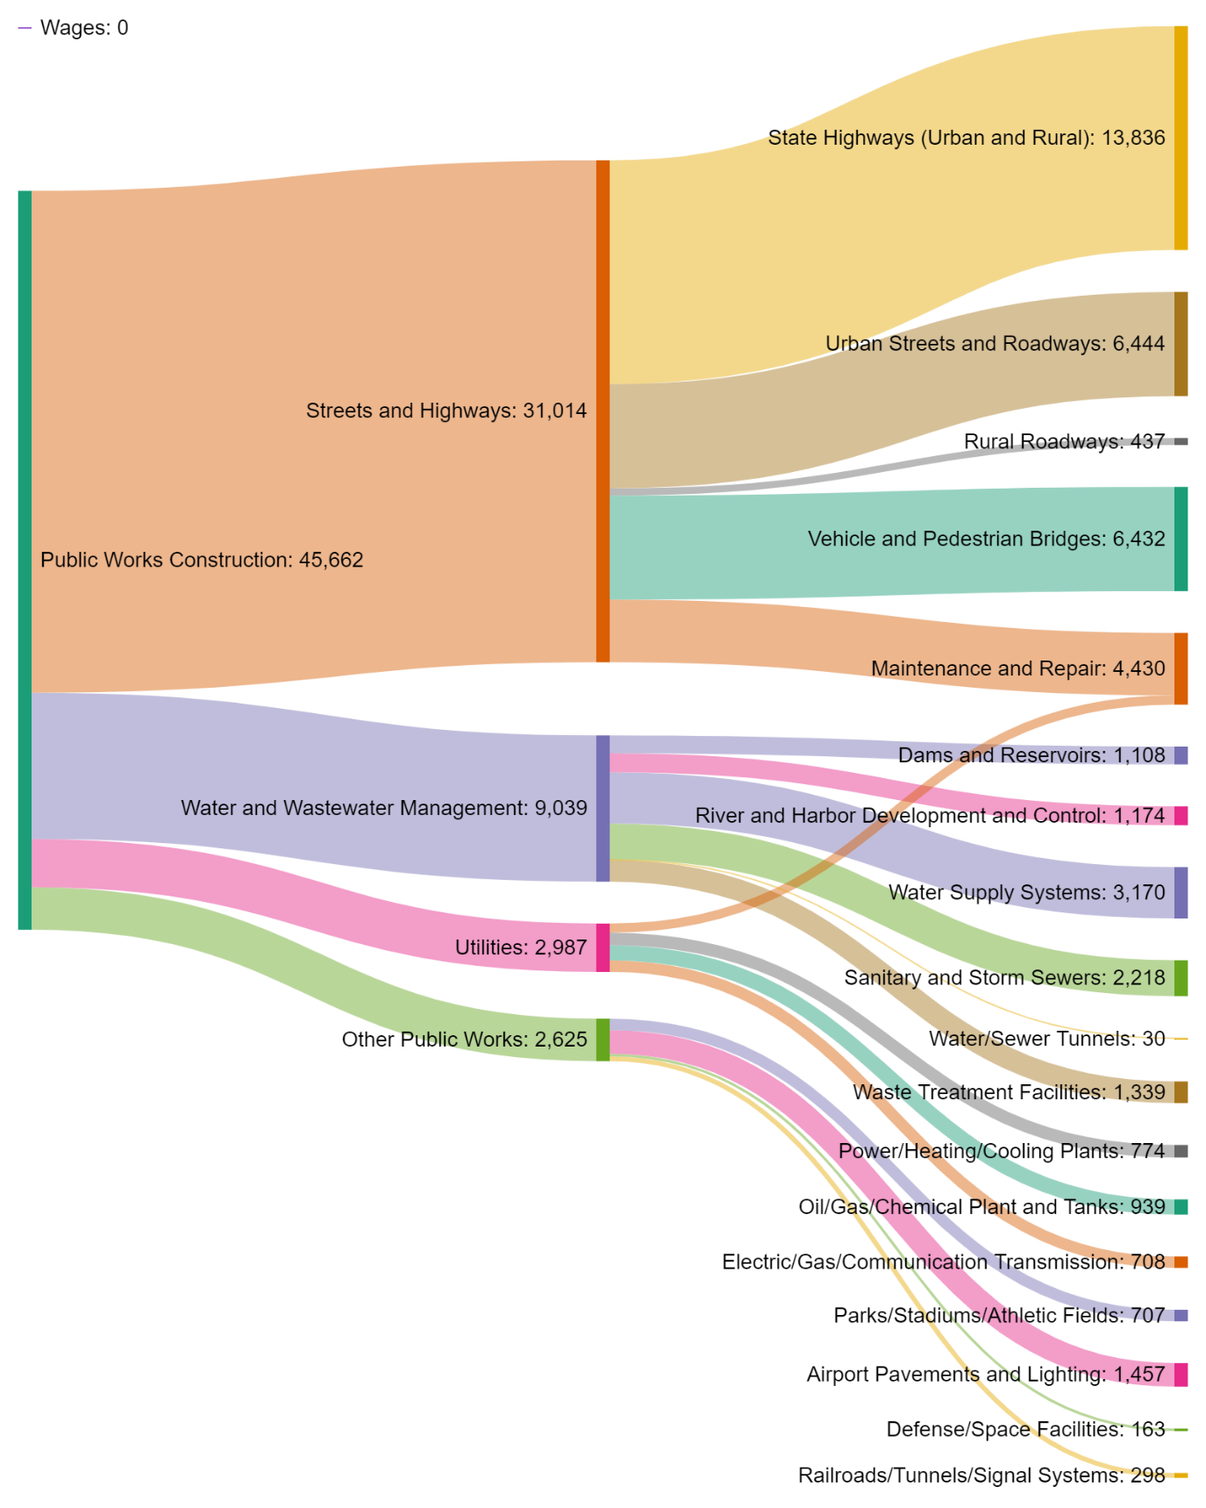
Where is portland cement being used?
Metric Tons (1000s)
Metric Tons (1000s)
Source: PCA State & Market Report, 2022

Slide 7
Freedonia 2020 Global Cement Report
Source: Freedonia Global Cement Report, 2021

Slide 8
USGS Data Jan 2020 – July 2023
Source: USGS Cement Statistics and Information, 2023

Slide 9

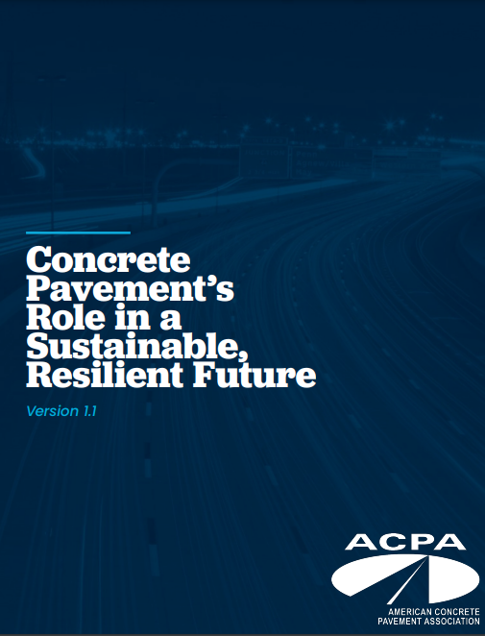
Path to Concrete Carbon Neutrality
Several roadmaps to carbon neutrality exist.
  Portland Cement Association.
    Clinker optimization (production enhancements, sequestration).
    Cement optimization (blended and alternative cements).
    Concrete optimization (reduced cementitious content, longevity).
    In-service and end-of life carbonation.
  American Concrete Pavement Association.
    Pavement design optimization (ME design).
    Life-cycle thinking (LCA, LCCA).
    Blended cements (PLC focus, other SCMs).
    Performance-engineered mixtures.

Slide 10
Quantifying
Environmental Impact

Slide 11
Environmental Life Cycle Assessment (eLCA)
Raw Material Acquisition
Material Processing
Manufacturing
Use
End of Life
M,E
M,E
M,E
M,E
M,E
T
T
T
T
W,P
Recycle
Remanufacture
Reuse
Recycle
W,P
W,P
M = Materials
E = Energy
W = Waste
P = Pollution
T = Transport
W,P
W,P
From: Kendall et al., 2012

Slide 12
Development of Environmental Product Declarations (EPDs)
Adapted from N. Santero by John Harvey
Product Category Rule (PCR)
  “Set of specific rules, requirements, and guidelines for developing Type III environmental product declarations for one or more product categories” (ISO 14025)
PCR: the framework
LCA: the analysis
Life Cycle Assessment (LCA)
  “Compilation and evaluation of the inputs, outputs and the potential environmental impacts of a product system throughout its life cycle” (ISO 14040)
Environmental Product Declaration (EPD)
  “Providing quantified environmental data using predetermined parameters and, where relevant, additional environmental information” (ISO 14025) as defined in a PCR which is based on LCA
EPD: the declaration

Slide 13
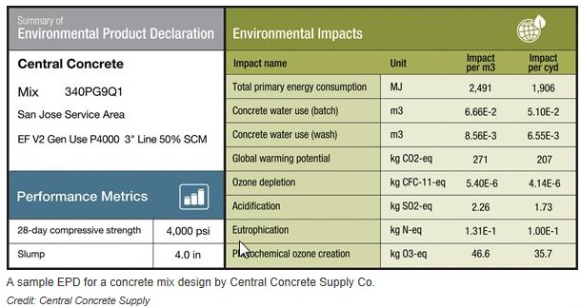
LCA is Used to Create the EPD
PCR
(the framework)
LCA
(the analysis)
EPD
(the declaration)
https://www.fhwa.dot.gov/pavement/sustainability/articles/environmental.cfm
Notes:
An LCA must first be developed that falls within the product category of the PCR
The LCA must follow the instructions in the pertinent PCR
An industry group will often conduct an initial national industry-average or regional-average LCA that uses typical values from across the country or region
An independent third party performs a critical review and verification of the LCA and EPD against the PCR, after which the Program Operator issues the EPD

Slide 14
Carbon Reduction
Strategies

Slide 15
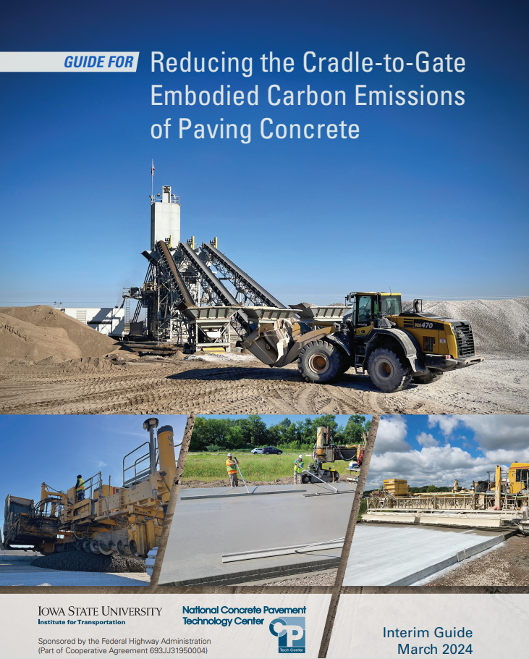
CP Tech Center’s Interim Guide, March 2024
5 Strategies:
  Target the cementitious binder.
  Target the concrete mixture to optimize binder content.
  Reduce the cradle-to-gate embodied carbon emissions of aggregates.
  Target mixture performance requirements.
  Consider other factors.

Slide 16
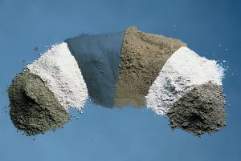
Target the Cementitious Binder
Reduce amount of Portland Cement Clinker
  Type IL Portland-Limestone Cement
  Type IP Portland-Pozzolan Cement
  Type IS Portland-Slag Cement
  Type IT Ternary Blended Cement
Increase Use of Supplementary Cementitious Materials
  Coal Fly Ash
  Slag Cement
  Silica Fume
  Ground Glass Pozzolan
  Alternative SCMs
Source: USGS Cement Statistics and Information, 2023
© Wilson & Tennis 2021 PCA

Slide 17
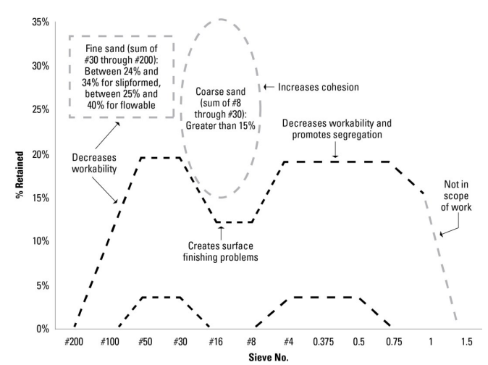
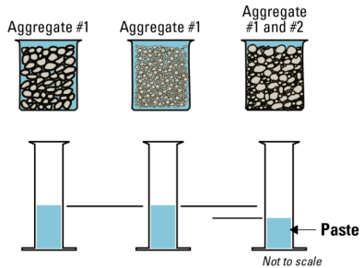
Target the Concrete Mixture to
Optimize Binder Content
Optimized aggregate gradation
Source: CP Tech Center, 2024

Slide 18
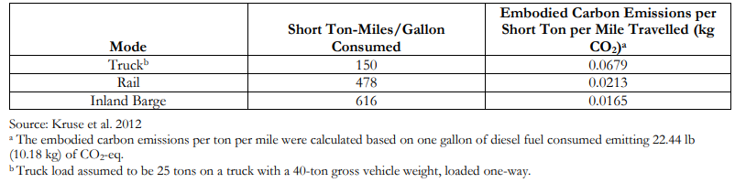
Reduce the Cradle-to-Gate Embodied Carbon Emissions of Aggregates
Reduce embodied carbon emissions in aggregate production and transportation.
Use recycled, waste, and byproduct materials as aggregate.
  Examples: RCA, air-cooled blast furnace slag, foundry sand, RAP
Use manufactured aggregates with reduced embodied carbon emissions.
  CO2 mineralization – carbon capture

Slide 19
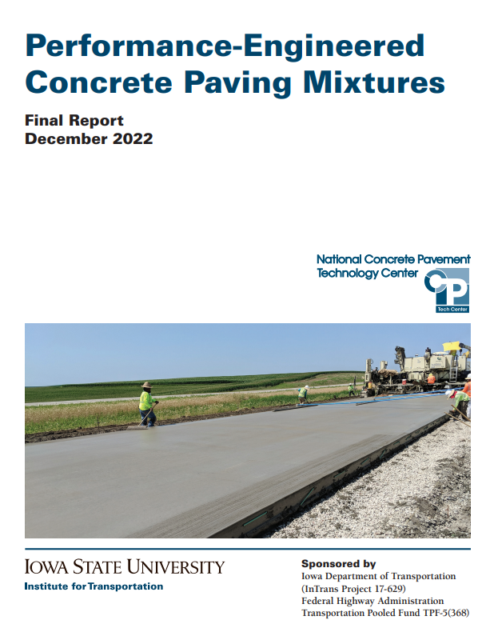
Target Mixture Performance Requirements
Removal of slump limits
Removal of prescriptive w/cm
Later age strength acceptance
In-place strength assessment with maturity
Removal of limits on cementitious materials amounts

Slide 20
Consider Other Factors
Reduce fuel consumption in the production and transportation of concrete
  Optimize plant operations to minimize the need to use diesel-powered heavy equipment to move aggregates once delivered.
  Reduce or eliminate the use of fossil-fuel generators for electricity generation. Instead, install local generators that rely on renewable energy sources and/or ensure that a connection to the electrical grid is available when siting a mobile plant.
Use calcium carbonate mineralization in the production of concrete

Slide 21
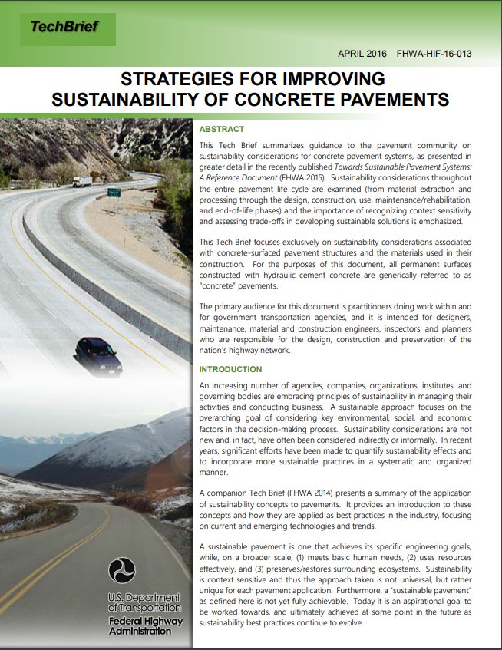
Additional Resources

Slide 22
Funding Opportunities
How can agencies get funding for these types of projects?

Slide 23
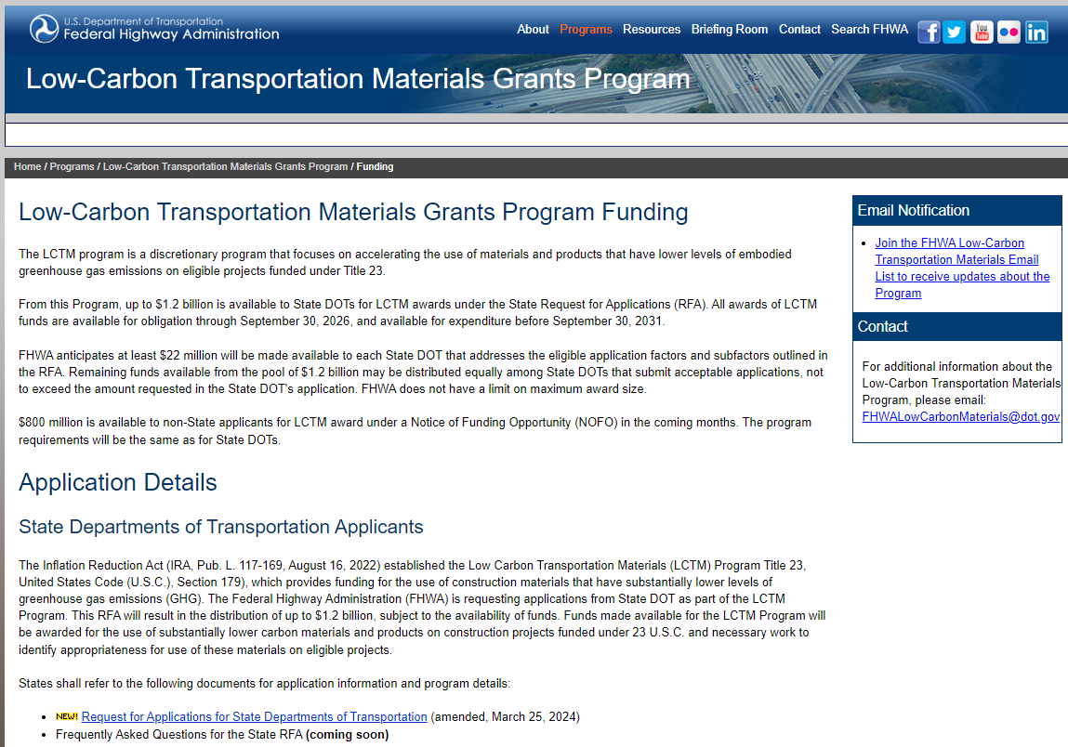
Low-Carbon Transportation Materials (LCTM) Grants
The Inflation Reduction Act Section 60506 provides for Low-Carbon Transportation Materials Grants
  $2B total available:
    $1.2B for State DOTs
    $800M for Non-State applicants
RFA for states is available and deadline is June 10th.
RFA for non-state applicants is expected in late May at Grants.gov
https://www.fhwa.dot.gov/lowcarbon/funding.cfm

Slide 24
Low-Carbon Transportation Materials (LCTM) Grants
Eligible Recipients
State
Unit of local government
Political subdivision of a State
Territory of the United States
Federally recognized Indian Tribe
Federal Land Management Agencies
Metropolitan Planning Organization (as defined in 23 U.S.C. 134(b)(2))
Special purpose district or public authority with a transportation function. [§ 60506; 23 U.S.C. 179(c)(2)]
Eligible Facilities
Federal-aid highway
Tribal transportation facility
Federal lands transportation facility
Federal lands access transportation facility [§ 60506; 23 U.S.C. 179(b)(4)(A)]
NOTE: Funds shall not be used for projects that result in additional travel through lanes for single occupant passenger vehicles.

Slide 25
What does it pay for?
Reimburse or incentive the use of construction materials and products that have substantially lower levels of embodied greenhouse gas emissions (GHGs), as defined by the Environmental Protection Agency (EPA).
Incentive: Eligible recipients may receive an incentive equal to 2% of the cost of using LCTM and on an eligible project.
Incremental: Eligible recipients may receive an amount of reimbursement equal to the incrementally higher cost of using LCTM relative to the cost of using traditional materials.

Slide 26

Expected Timing for Non-State Applicants
Early Summer 2024 Applications Available
Late Summer 2024 Applications due to FHWA
Late Summer/ Early Fall 2024 Award Announcements
Fall 2026 Funds must be obligated
Fall 2031 Funds must be expended

Slide 27
Things to Keep in Mind
  Which material(s) to consider
  What are your agency’s priority LCTM strategies?
    Cement/Concrete: optimized gradation, PLC, SCM
    Asphalt: reclaimed asphalt cement, warm mix, in-place recycling
  Candidate projects—Title 23
  What/how to monitor performance?

Slide 28

How can NCE help?
“Reduced Carbon Concrete Consortium”
  Funding to assist agencies to apply for IRA $$ to include reduced carbon concrete in infrastructure projects
    Pavement, sidewalks, curb and gutter, medians, etc.
    Material selection, grant applications, construction coordination and support, EPD development, monitoring, data collection, dissemination of results

Slide 29


Questions?
Kevin Senn, PE
ksenn@ncenet.com
Sarah Lopez, PE
slopez@ncenet.com

